Slide 1

CS 533 INTRO TO DATA SCIENCE
Michael Ekstrand

Slide 2
CONTROL STRUCTURES

Slide 3

Learning Outcomes
Write basic Python control structures
Understand Python block syntax
Know standard practice for whitespace
Key concept: Python uses whitespace to detect blocks, such as the bodies of loops or conditionals.
Photo by gryffyn m on Unsplash

Slide 4
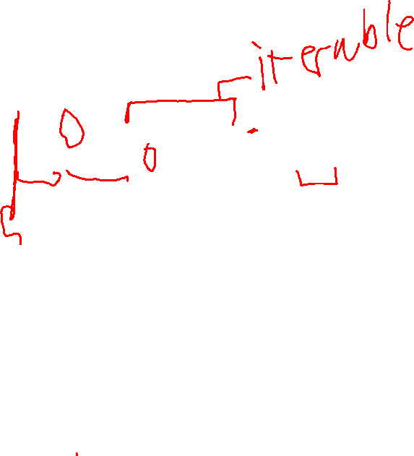
For Loops
for i in range(5): print(f'iteration {i}') print('done')
Iterate over an iterable
range(5) iterates 0, 1, 2, 3, 4
Whitespace delimits blocks

Slide 5

Blocks
for i in range(5): print(f'iteration {i}’) print('done')
Python blocks begin with ‘:’ at the end of a line
if, else, elif, for, while, def, class
Block content is indented one level
Standard practice is 4 spaces (Jupyter defaults to this)
Block ends when indentation returns to previous level

Slide 6
Comments
Python comments
Begin with ‘#’
Continue until end of line
# this is a comment
print('foo') # can comment here too

Slide 7
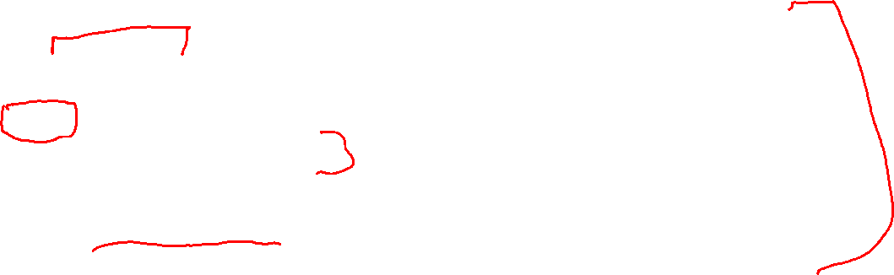
If Statements
x = 5 if x >= 10: print('big') elif x >= 5: print('medium') else: print('small')
These are false:
False (Boolean value)
None (equiv. to null)
0
Empty list, set, or tuple ([])
Empty string('')
Most other things are true.

Slide 8
While Loops
while condition: # do something pass
Iterates until condition is false
‘pass’ does nothing
Here only to make it valid Python

Slide 9

Wrapping Up
Python provides the usual control structures (if, for, while)
Blocks are based on indentation
'#' starts a comment
Photo by Erik Kroon on Unsplash

